Slide 1
Fast and Robust Distributed Subgraph Enumeration 汇报人：李靖东

Slide 2
Outlines
Preliminaries
RADS
Heuristics
Experiment results
Conclusion

Slide 3
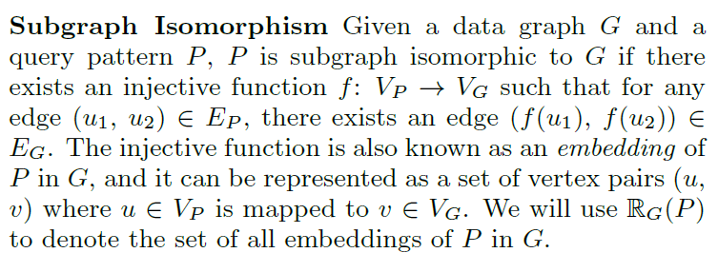

Subgraph enumeration
The problem of subgraph enumeration is to find the set $R_{G}(P)$.
In the literature, subgraph enumeration is also referred to as ：
subgraph isomorphism search
X. Ren and J. Wang. Exploiting vertex relationships in speeding up subgraph isomorphism over large graphs.(VLDB15’)
subgraph listing
Y. Shao, B. Cui, L. Chen, L. Ma, J. Yao, and N. Xu.Parallel subgraph listing in a large-scale graph. (SIGMOD14’)

Slide 4
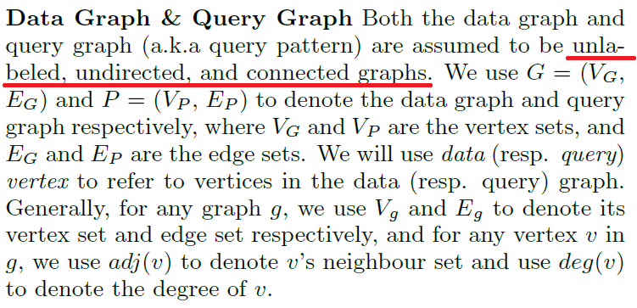
Data Graph & Query Graph

Slide 5
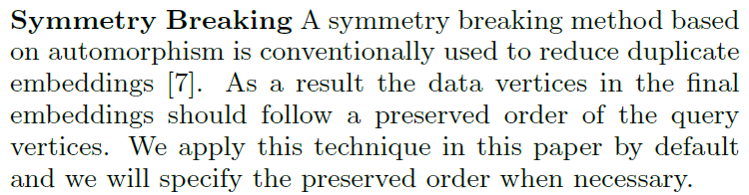
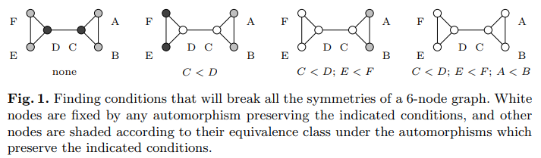
Symmetry Breaking

Slide 6
Single Machine Settings
Single Machine Algorithms
Ullmann’s algorithm[J.ACM’76]
VF2[IEEE Trans’04]
QuickSI[VLDB’08]
TurboIso[SIGMOD’13]
BoostIso[VLDB’15]
Phenomenon
The data graphs are often fragmented and distributed across different sites.
The increasing size of modern graph makes it hard to load the whole graph into memory.

Slide 7
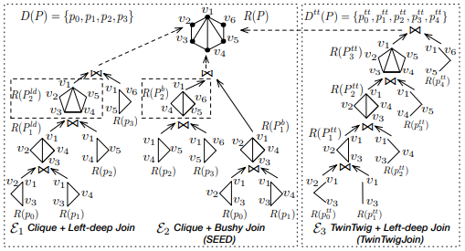
Distributed Settings
Join
TwinTwig[VLDB’15]
SEED[VLDB’16]
System Architecture
PSgL[VLDB’12]
GRAPE[SIGMOD’17]
AAP[SIGMOD’18]
Compression
CBF[VLDB’17] (Core-crystal decomposition)

Slide 8
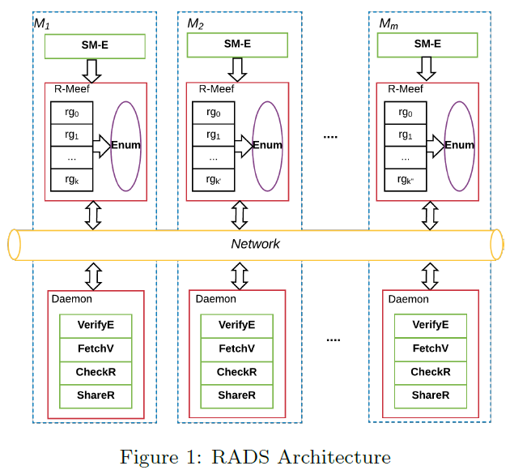
RADS
A Robust Asynchronous Distributed Subgraph enumeration system.
Asynchronous
Index free
Light communication cost
Reduces and compresses
intermediate results.
Notes:
给定查询图P，在每台机器中，RADS会同时开始一个SM-E进程和一个Daemon线程，在SM-E进程结束后后开始一个R-Meef线程，不同机器的R-Meef开始的时间会不一样。

Slide 9
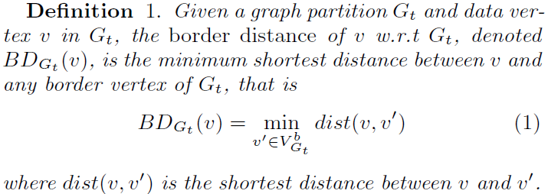

Single-Machine Enumeration(SM-E)
Border distance
v
$$G_{t}$$
v

Slide 10
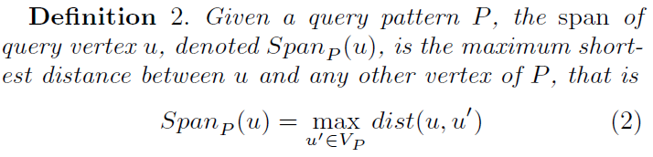
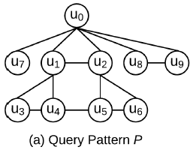

Single-Machine Enumeration(SM-E)
Span
$Span_{p}{(u}_{1})$= 2
$Span_{p}{(u}_{3})$= 3

Slide 11
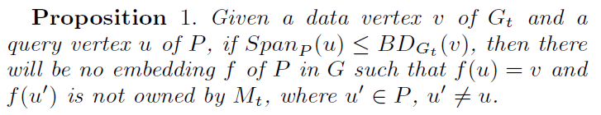


Single-Machine Enumeration(SM-E)
v
v
$$G_{t}$$
$$G_{t}$$
v
v

Slide 12
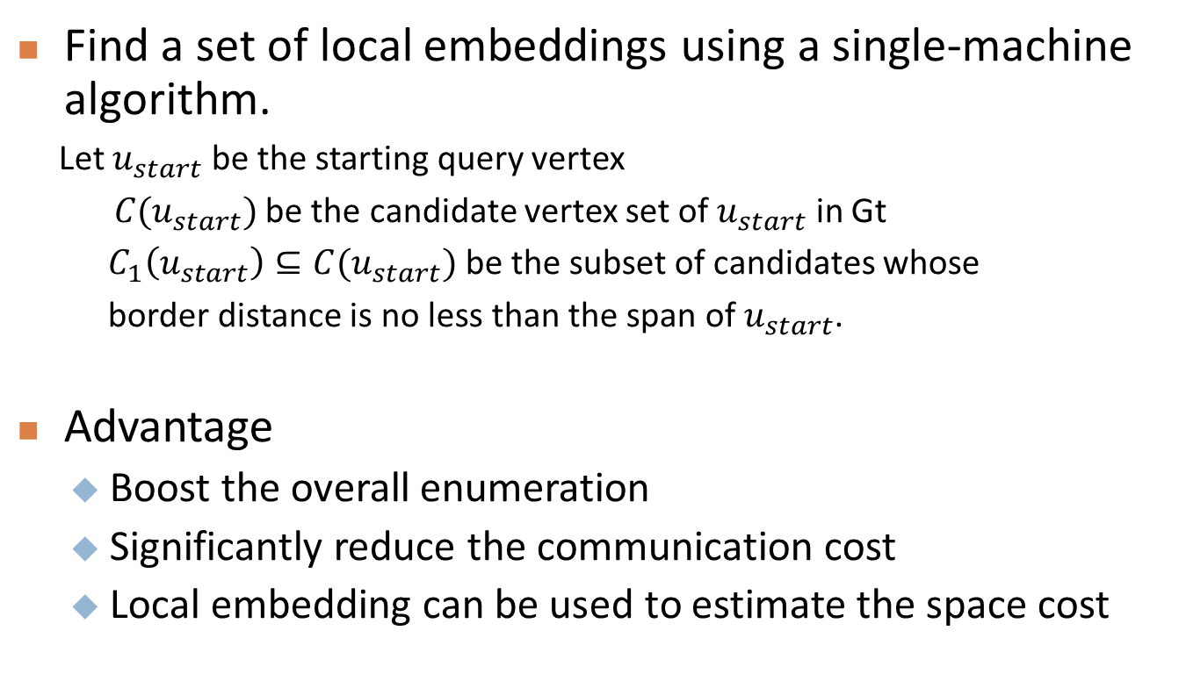
Single-Machine Enumeration(SM-E)
Find a set of local embeddings using a single-machine algorithm.
Let $u_{start}$ be the starting query vertex
$C(u_{start})$be the candidate vertex set of $u_{start}$ in Gt
$C_{1}\left(u_{start}\right)⊆C(u_{start})$ be the subset of candidates whose
border distance is no less than the span of $u_{start}$.
Advantage
Boost the overall enumeration
Significantly reduce the communication cost
Local embedding can be used to estimate the space cost

Slide 13
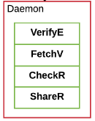
Daemon Thread
Listens to requests from other machines and supports four functionalities:
VerifyE: return the edge verification results for a given request
FetchV: return the adj-lists of the requested vertices
CheckR: return the number of unprocessed region groups of the local machine
ShareR: return an unprocessed region group of the local machine to the requester machine
CheckR and ShareR are for load balancing purposes only
Notes:
剩下的分布式进程包括daemon和subgraph enumeration线程R-Meef
一旦本地机器完成了对自己本地region groups的处理，它将向其它机器广播一个checkR请求。 一旦收到来自其他计算机的未完成的数量后，它将发送一个shareR请求给最大值的机器。收到region groups后，它将在本地计算机上处理它。 checkR和shareR仅用于负载平衡目的，而不会本文将进一步讨论。

Slide 14
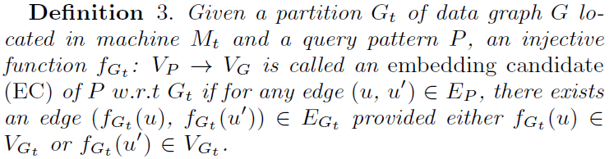
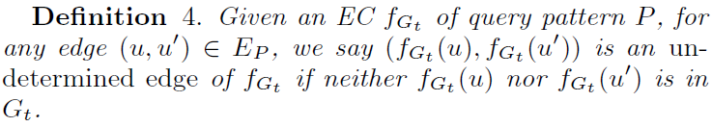







Some Definitions
$$G_{t}$$
$$u_{0}$$
$$u_{2}$$
Send a VerifyE
$$v_{0}$$
$$v_{2}$$
$$u_{1}$$
$$v_{1}$$
Notes:
在介绍R-Meef框架之前，需要介绍一下如下定义：

Slide 15
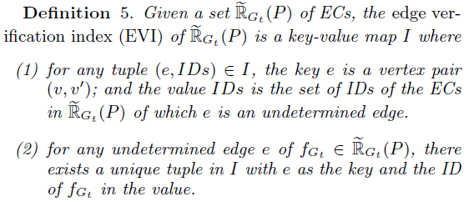
Edge Verification Index (EVI)
Notable: It is possible that an undetermined edge is shared by multiple ECs.
To reduce network traffic, we do not send VerifyE requests once for each individual EC. Using EVI
to identify ECs that share undetermined edges

Slide 16
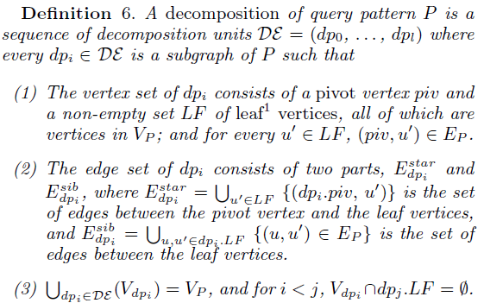
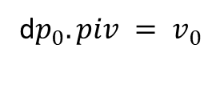



Pattern Graph Decomposition
d$p_{0}.piv = v_{0}$
$$v_{0}$$
$$v_{2}$$
$$v_{1}$$

Slide 17

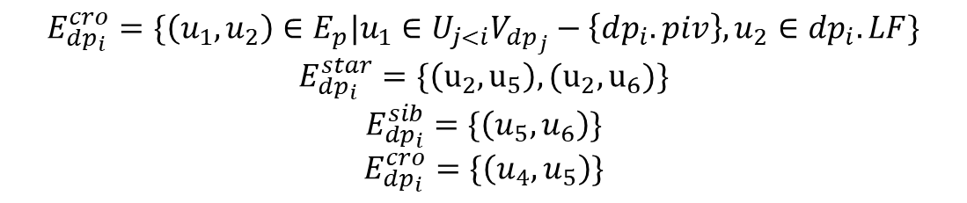
Example
A Decomposition :(dp0, dp1, dp2, dp3)
$$dp_{0}.piv =u_{0} dp_{0}.LF =\{u_{1}, u_{2}, u_{7}\}$$
$$dp_{1}.piv=u_{1} dp_{1}.LF=\{u_{3},u_{4}\}$$
$$dp_{2}.piv=u_{2} dp_{2}.LF=\{u_{5}, u_{6}\}$$
$$dp_{3}.piv=u_{0} dp_{3}.LF =\{u_{8},u_{9}\}$$
$$E_{dp_{i}}^{cro}=\{\left(u_{1},u_{2}\right)∈E_{p}|u_{1}∈U_{j<i}V_{dp_{j}}−\left\{dp_{i}.piv\right\},u_{2}∈dp_{i}.LF\}$$
$$E_{dp_{i}}^{star}=\{\left(u_{2},u_{5}\right),(u_{2},u_{6})\}$$
$$E_{dp_{i}}^{sib}=\{\left(u_{5},u_{6}\right)\}$$
$$E_{dp_{i}}^{cro}=\{\left(u_{4},u_{5}\right)\}$$
sibling edges and cross-unit edges are both called verification edges.

Slide 18
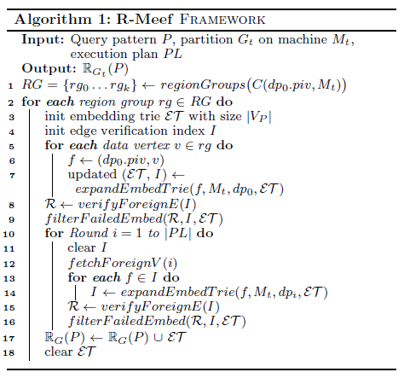
R-Meef Thread
the core subgraph enumeration thread

Slide 19
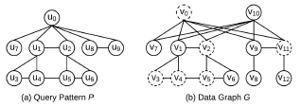
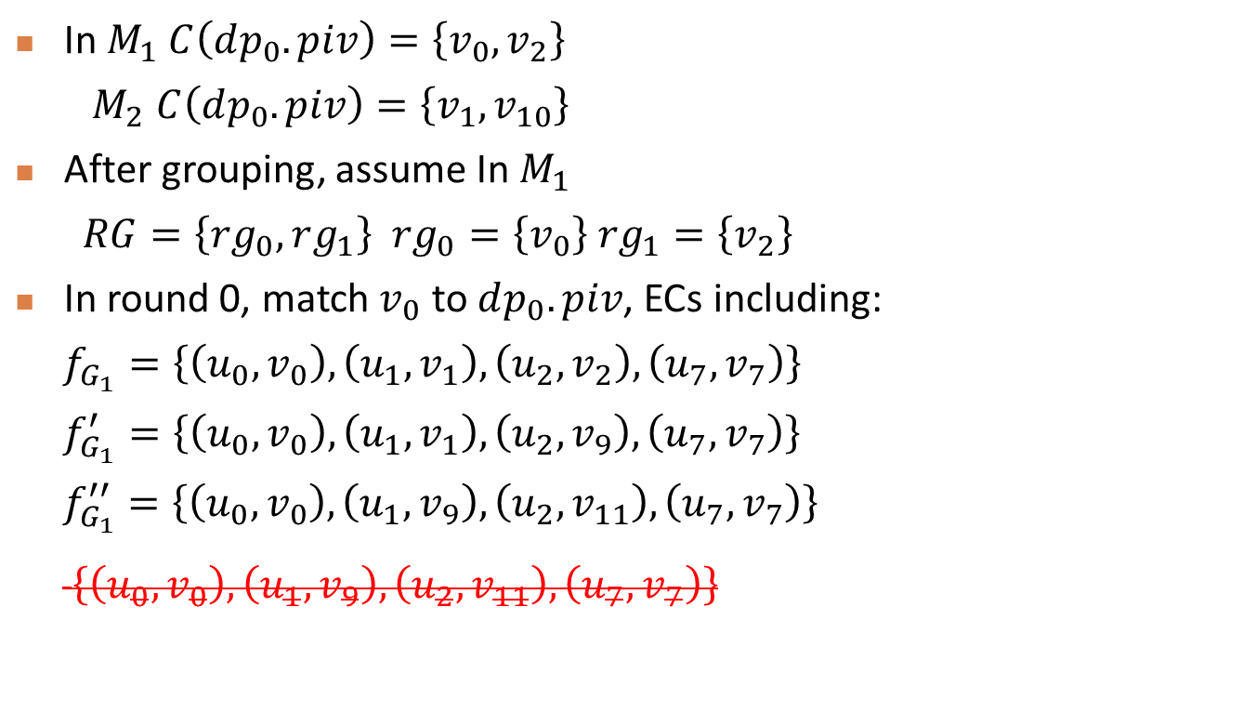
Example
In $M_{1}$ $C\left(dp_{0}.piv\right)=\left\{v_{0},v_{2}\right\}$
$M_{2}$ $C\left(dp_{0}.piv\right)=\left\{v_{1},v_{10}\right\}$
After grouping, assume In $M_{1}$
$RG=\left\{rg_{0},rg_{1}\right\} rg_{0}=\left\{v_{0}\right\} rg_{1}=\left\{v_{2}\right\}$
In round 0, match $v_{0}$ to $dp_{0}.piv$, ECs including:
$f_{G_{1}}=\left\{\left(u_{0},v_{0}\right),\left(u_{1},v_{1}\right),\left(u_{2},v_{2}\right),\left(u_{7},v_{7}\right)\right\}$
$f_{G_{1}}^{′}=\left\{\left(u_{0},v_{0}\right),\left(u_{1},v_{1}\right),\left(u_{2},v_{9}\right),\left(u_{7},v_{7}\right)\right\}$
$f_{G_{1}}^{′′}=\left\{\left(u_{0},v_{0}\right),\left(u_{1},v_{9}\right),\left(u_{2},v_{11}\right),\left(u_{7},v_{7}\right)\right\}$
$\left\{\left(u_{0},v_{0}\right),\left(u_{1},v_{9}\right),\left(u_{2},v_{11}\right),\left(u_{7},v_{7}\right)\right\}$
Notes:
symmetry breaking are: u1 < u2, u3< u6, u4 < u5 and u8 < u9
ECs中不包含能被local验证不符合的匹配 如：

Slide 20
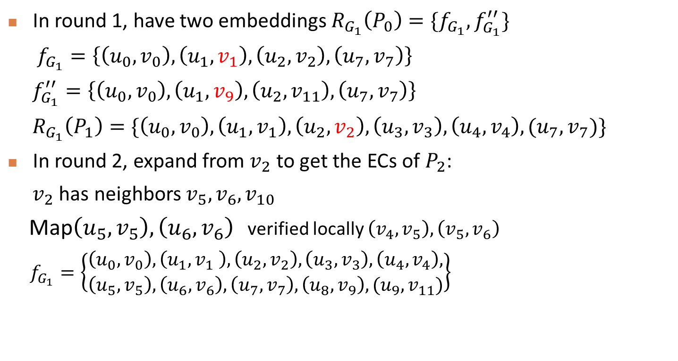
Example
In round 1, have two embeddings $R_{G_{1}}\left(P_{0}\right)=\{f_{G_{1}},f_{G_{1}}^{′′}\}$
$f_{G_{1}}=\left\{\left(u_{0},v_{0}\right),\left(u_{1},v_{1}\right),\left(u_{2},v_{2}\right),\left(u_{7},v_{7}\right)\right\}$
$f_{G_{1}}^{′′}=\left\{\left(u_{0},v_{0}\right),\left(u_{1},v_{9}\right),\left(u_{2},v_{11}\right),\left(u_{7},v_{7}\right)\right\}$
$R_{G_{1}}\left(P_{1}\right)=\{\left(u_{0},v_{0}\right),\left(u_{1},v_{1}\right),\left(u_{2},v_{2}\right),\left(u_{3},v_{3}\right),\left(u_{4},v_{4}\right),(u_{7},v_{7})\}$
In round 2, expand from $v_{2}$ to get the ECs of $P_{2}$:
$v_{2}$ has neighbors $v_{5},v_{6},v_{10}$
Map$\left(u_{5},v_{5}\right),\left(u_{6},v_{6}\right)$ verified locally $\left(v_{4},v_{5}\right),\left(v_{5},v_{6}\right)$
$f_{G_{1}}=\left\{\begin{aligned}\left(u_{0},v_{0}\right),\left(u_{1},v_{1} \right),\left(u_{2},v_{2}\right),\left(u_{3},v_{3}\right),\left(u_{4},v_{4}\right), \\ \left(u_{5},v_{5}\right),\left(u_{6},v_{6}\right),\left(u_{7},v_{7}\right),\left(u_{8},v_{9}\right),(u_{9},v_{11})\end{aligned}\right\}$
Notes:
向M2询问邻接信息

Slide 21
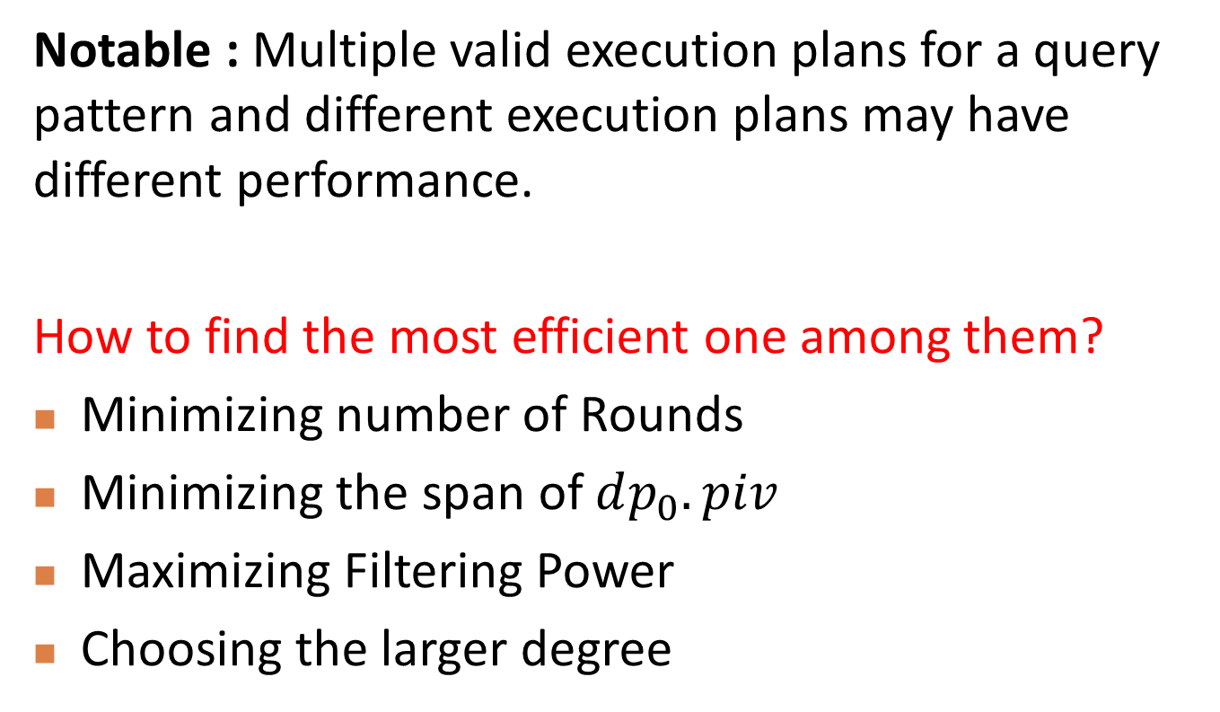
Computing Execution Plan
Notable : Multiple valid execution plans for a query pattern and different execution plans may have different performance.
How to find the most efficient one among them?
Minimizing number of Rounds
Minimizing the span of $dp_{0}.piv$
Maximizing Filtering Power
Choosing the larger degree

Slide 22
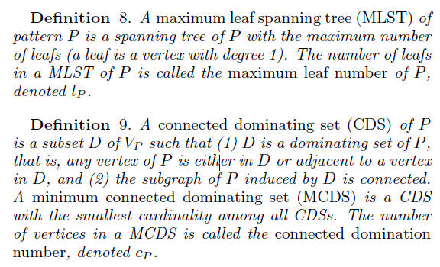






Minimizing Number of Rounds
Intuition: the cost of fetching and memory space can be shared among multiple embedding candidates if they happen to be in the same round(maximize the workload sharing)
CDS
CDS
$$u_{0}$$
$$u_{2}$$
$$u_{1}$$
MCDS
$$u_{4}$$
$$u_{3}$$
$${|V}_{p}|=c_{p}+l_{p}$$
Notes:
https://en.wikipedia.org/wiki/Connected_dominating_set

Slide 23

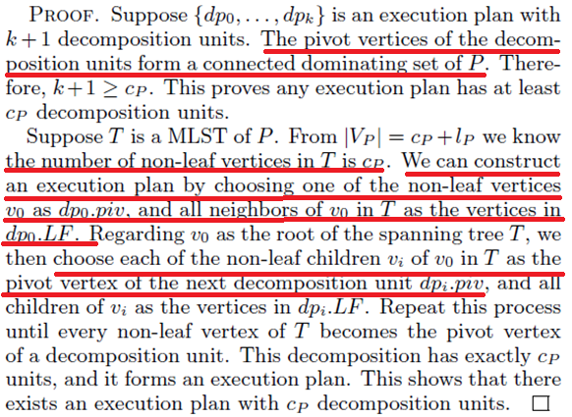
Minimizing Number of Rounds

Slide 24
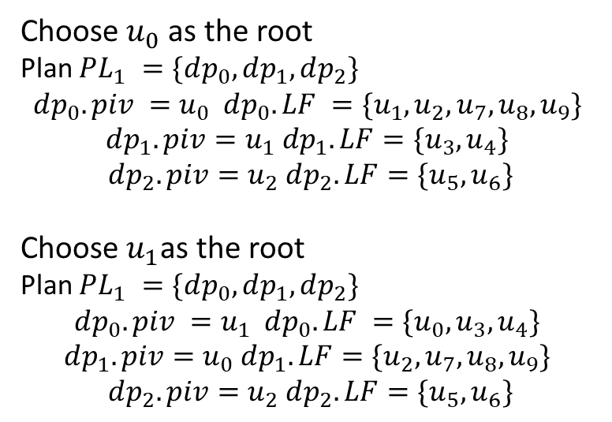
Example
Choose $u_{0}$ as the root
Plan $PL_{1} =\{dp_{0}, dp_{1}, dp_{2}\}$
$$dp_{0}.piv =u_{0} dp_{0}.LF =\{u_{1}, u_{2}, u_{7},u_{8},u_{9}\}$$
$$dp_{1}.piv=u_{1} dp_{1}.LF=\{u_{3},u_{4}\}$$
$$dp_{2}.piv=u_{2} dp_{2}.LF=\{u_{5}, u_{6}\}$$
Choose$u_{1}$as the root
Plan $PL_{1} =\{dp_{0}, dp_{1}, dp_{2}\}$
$$dp_{0}.piv =u_{1} dp_{0}.LF =\{u_{0}, u_{3}, u_{4}\}$$
$$dp_{1}.piv=u_{0} dp_{1}.LF=\{u_{2},u_{7},u_{8},u_{9}\}$$
$$dp_{2}.piv=u_{2} dp_{2}.LF=\{u_{5}, u_{6}\}$$

Slide 25
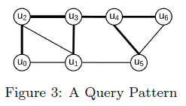

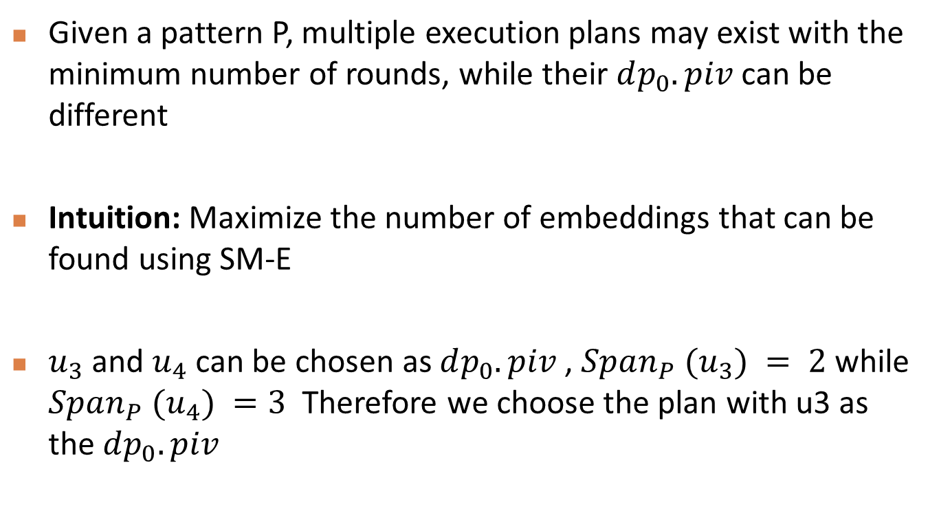
Minimizing the Span of $dp_{0}.piv$
Given a pattern P, multiple execution plans may exist with the minimum number of rounds, while their $dp_{0}.piv$ can be different
Intuition: Maximize the number of embeddings that can be found using SM-E
$u_{3}$ and $u_{4}$ can be chosen as $dp_{0}.piv$ , $Span_{P} (u_{3}) = 2$while $Span_{P} (u_{4}) =3$ Therefore we choose the plan with u3 as the $dp_{0}.piv$

Slide 26

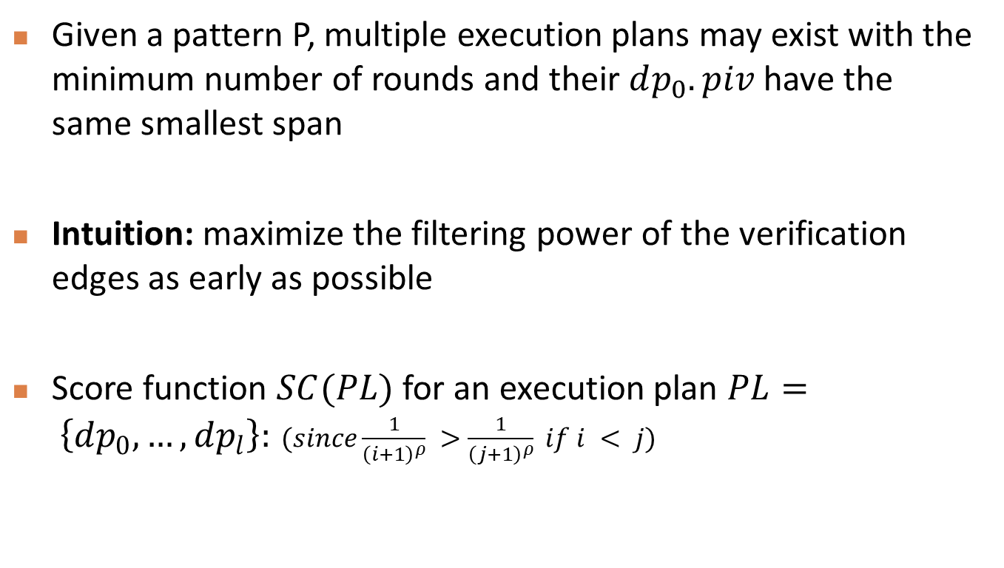
Maximizing Filtering Power
Given a pattern P, multiple execution plans may exist with the minimum number of rounds and their $dp_{0}.piv$ have the same smallest span
Intuition: maximize the filtering power of the verification edges as early as possible
Score function $SC(PL)$for an execution plan $PL= \left\{dp_{0}, …, dp_{l}\right\}:$ $(since\frac{1}{{\left(i+1\right)}^{ρ}} >\frac{1}{{\left(j+1\right)}^{ρ}} if i < j)$
Notes:
实验中设置P=1 i越小权重越大

Slide 27
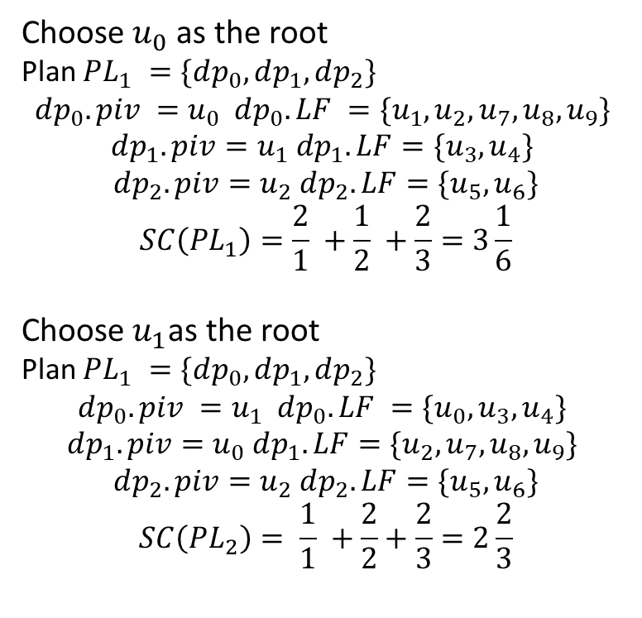
Example
Choose $u_{0}$ as the root
Plan $PL_{1} =\{dp_{0}, dp_{1}, dp_{2}\}$
$$dp_{0}.piv =u_{0} dp_{0}.LF =\{u_{1}, u_{2}, u_{7},u_{8},u_{9}\}$$
$$dp_{1}.piv=u_{1} dp_{1}.LF=\{u_{3},u_{4}\}$$
$$dp_{2}.piv=u_{2} dp_{2}.LF=\{u_{5}, u_{6}\}$$
$$SC\left(PL_{1}\right)=\frac{2}{1} +\frac{1}{2} +\frac{2}{3}=3\frac{1}{6}$$
Choose$u_{1}$as the root
Plan $PL_{1} =\{dp_{0}, dp_{1}, dp_{2}\}$
$$dp_{0}.piv =u_{1} dp_{0}.LF =\{u_{0}, u_{3}, u_{4}\}$$
$$dp_{1}.piv=u_{0} dp_{1}.LF=\{u_{2},u_{7},u_{8},u_{9}\}$$
$$dp_{2}.piv=u_{2} dp_{2}.LF=\{u_{5}, u_{6}\}$$
$$SC\left(PL_{2}\right)= \frac{1}{1} +\frac{2}{2}+\frac{2}{3}=2\frac{2}{3}$$

Slide 28
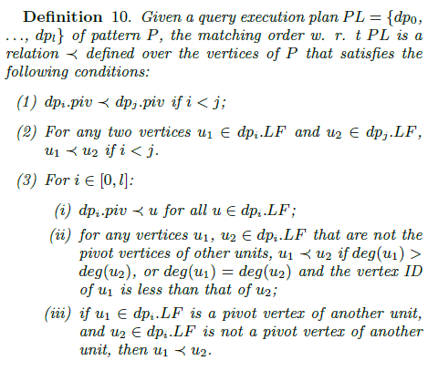
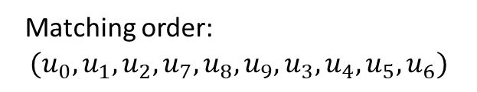
Embedding Trie
Data structure used for compressing the intermediate results
Matching order:
$$(u_{0},u_{1},u_{2},u_{7},u_{8},u_{9},u_{3},u_{4},u_{5},u_{6})$$

Slide 29
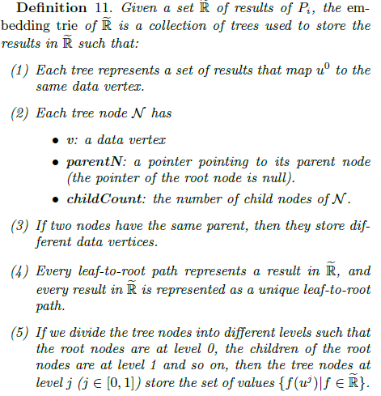
Structure of the Embedding Trie

Slide 30
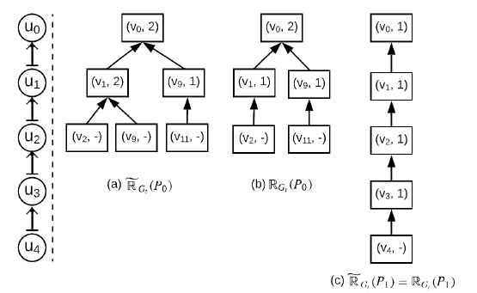
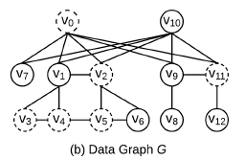
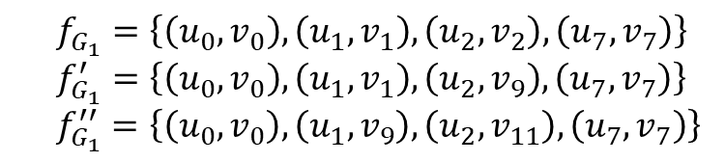
Example
$f_{G_{1}}=\left\{\left(u_{0},v_{0}\right),\left(u_{1},v_{1}\right),\left(u_{2},v_{2}\right),\left(u_{7},v_{7}\right)\right\}$
$f_{G_{1}}^{′}=\left\{\left(u_{0},v_{0}\right),\left(u_{1},v_{1}\right),\left(u_{2},v_{9}\right),\left(u_{7},v_{7}\right)\right\}$
$f_{G_{1}}^{′′}=\left\{\left(u_{0},v_{0}\right),\left(u_{1},v_{9}\right),\left(u_{2},v_{11}\right),\left(u_{7},v_{7}\right)\right\}$
$R_{G_{1}}\left(P_{1}\right)=\{\left(u_{0},v_{0}\right),\left(u_{1},v_{1}\right),\left(u_{2},v_{2} \right),\left(u_{3},v_{3}\right),\left(u_{4},v_{4}\right),(u_{7},v_{7})\}$

Slide 31
Nice Properties:
Compression
Storing the results in the embedding trie saves space than storing them as a collection of lists.
Unique ID
For each result in the embedding trie, the address of its leaf node in memory can be used as the unique ID.
Retrieval
Given a particular ID represented by a leaf node, we can easily
follow its pointer step-by-step to retrieve the corresponding result.
Removal
To remove a result with a particular ID, we can remove its corresponding leaf node and decrease the childCount of its parent node by 1.

Slide 32
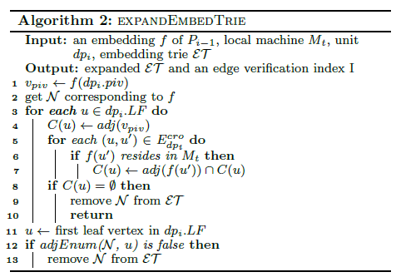
Maintaining the Embedding Trie

Slide 33
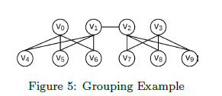
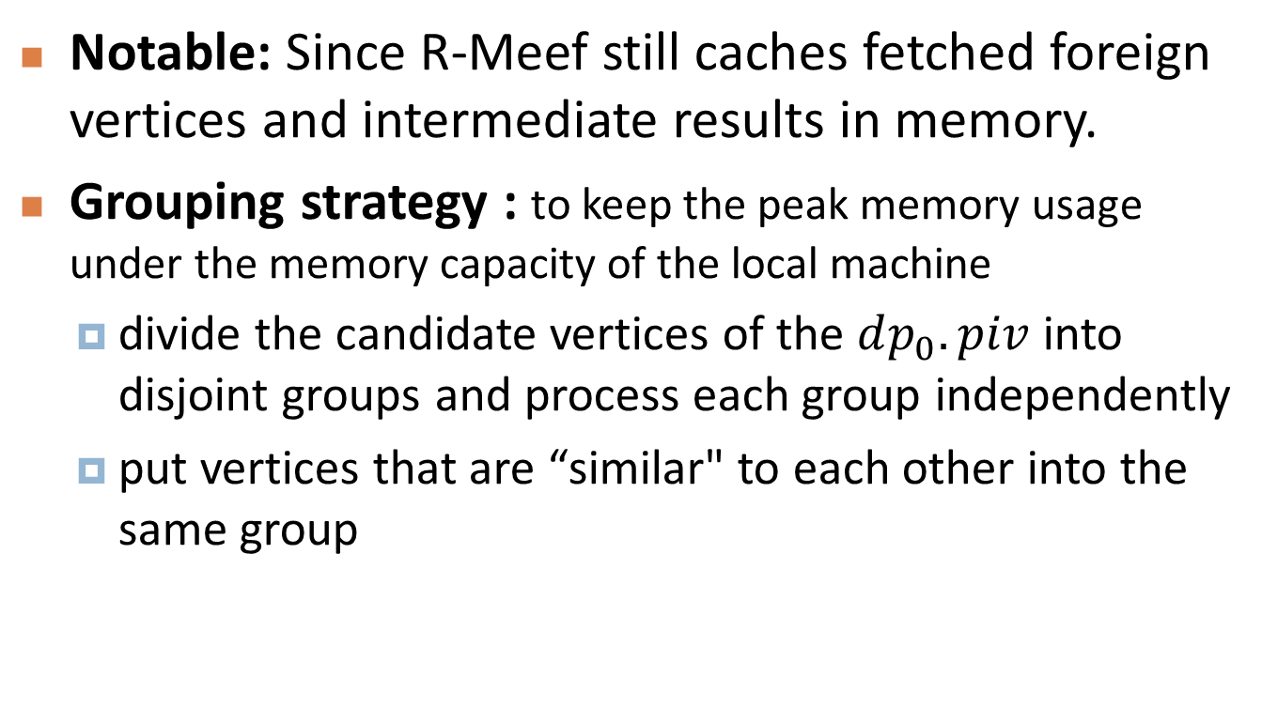
Memory Control Strategies
Notable: Since R-Meef still caches fetched foreign vertices and intermediate results in memory.
Grouping strategy : to keep the peak memory usage under the memory capacity of the local machine
divide the candidate vertices of the $dp_{0}.piv$ into disjoint groups and process each group independently
put vertices that are “similar" to each other into the same group

Slide 34
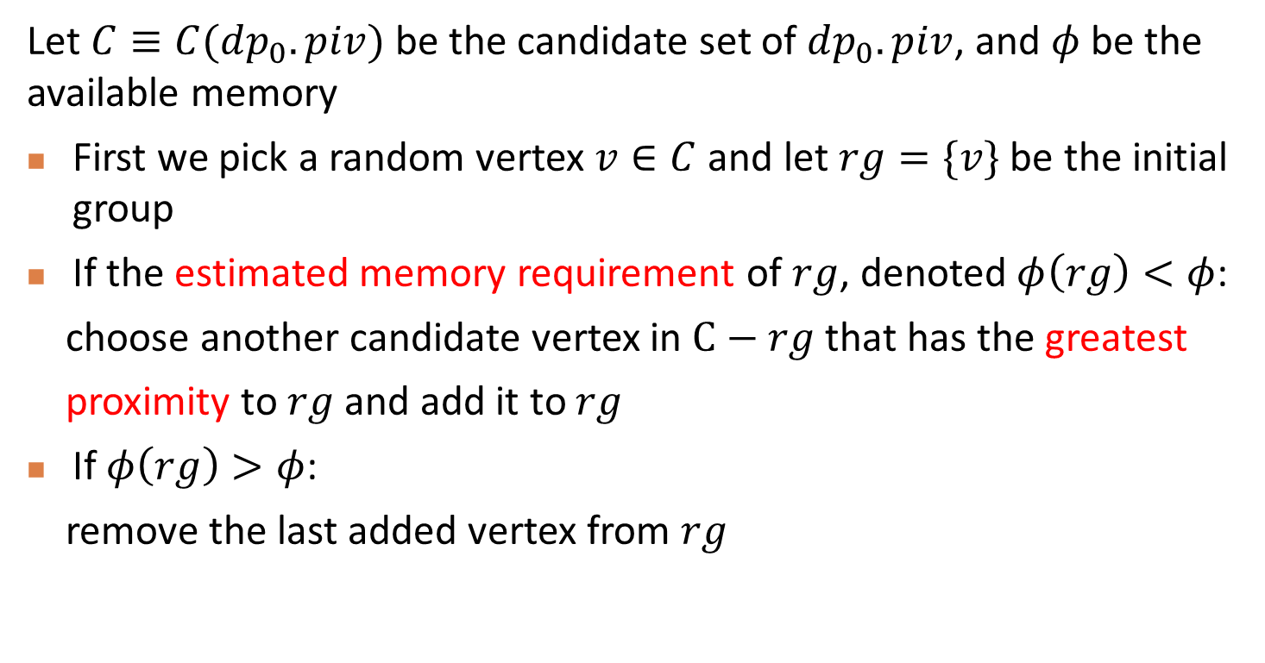
Memory Control Strategies
Let $C≡C(dp_{0}.piv)$be the candidate set of $dp_{0}.piv$, and $φ$be the available memory
First we pick a random vertex $v∈C$and let $rg=\{v\}$ be the initial group
If the estimated memory requirement of $rg$, denoted$φ\left(rg\right)<φ$:
choose another candidate vertex in $C−rg$that has the greatest
proximity to $rg$ and add it to $rg$
If $φ\left(rg\right)>φ$:
remove the last added vertex from $rg$

Slide 35

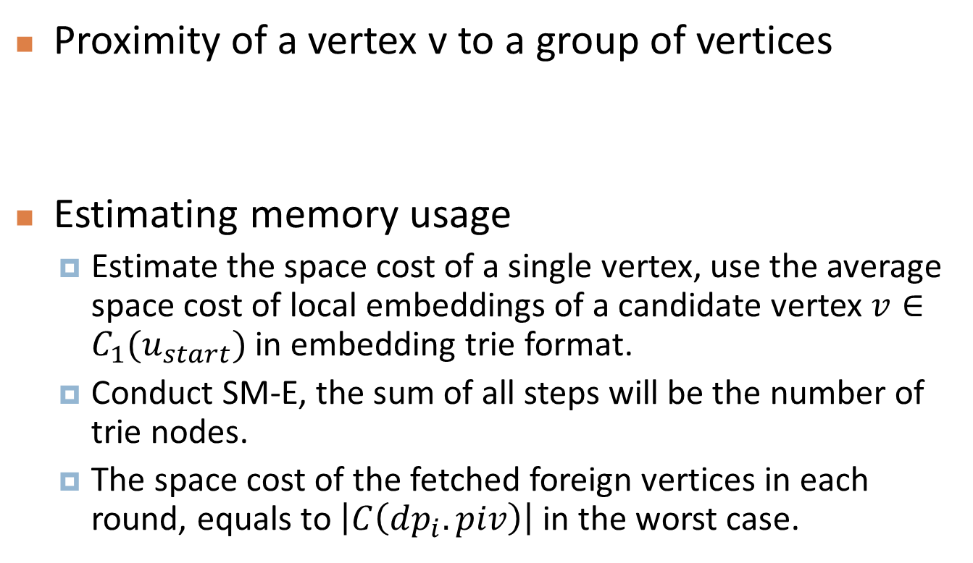
Memory Control Strategies
Proximity of a vertex v to a group of vertices
Estimating memory usage
Estimate the space cost of a single vertex, use the average space cost of local embeddings of a candidate vertex $v∈C_{1}(u_{start})$ in embedding trie format.
Conduct SM-E, the sum of all steps will be the number of trie nodes.
The space cost of the fetched foreign vertices in each round, equals to $\left|C\left(dp_{i}.piv\right)\right|$in the worst case.

Slide 36
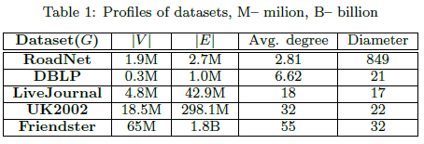
Experiments Setting
Four state-of-the-art distributed subgraph enumeration approaches:
PSgL (based on Pregel)
TwinTwig (using joining approach, based on MapReduce)
SEED (upgraded version of TwinTwig, supporting clique decomposition unit)
Crystal (relying on clique-index and compression, using MapReduce)
Environment
10 machines equipped with Intel CPU with 16 Cores and 16G memory.
Dataset & Queries
Notes:
作者的代码是用c++的mpich2库和boost库辅助实现的
作者使用了TurboIso作为单机的算法
作者利用MPI库实现了上述三种算法，最后一种是作者提供的代码

Slide 37
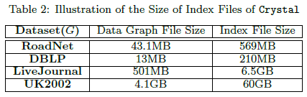
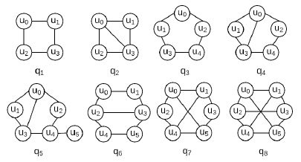
Experiments Setting
Data graphs are stored in plain text format where each line represents an adjacency-list of a vertex
Using Metis to partition the data graphs and each machine randomly picks up one partition
Crystal relies on the clique-index of the data graph which should be pre-constructed and stored on disk.
The queries used are shown right：

Slide 38
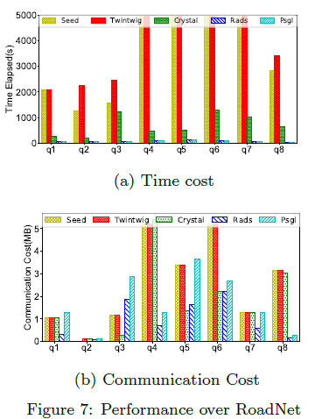
RoadNet Dataset Results
RADS PSgL :
Using graph exploration
SEED TwinTwig:
Using join-based methods, need to group the intermediate results based on keys so as to join them together, their performance was dragged down when dealing with sparse graphs
Crystal:
The number of cliques in RoadNet is relatively small considering the graph size.

Slide 39
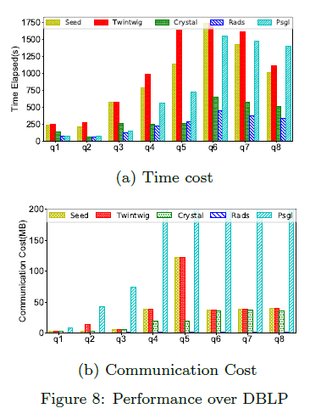
DBLP Dataset Results
PSgL :
Does not consider any compression or grouping of intermediate results
The time delay due to shuffling the intermediate results caused bad performance
SEED TwinTwig:
the time cost of grouping intermediate results is high as well

Slide 40
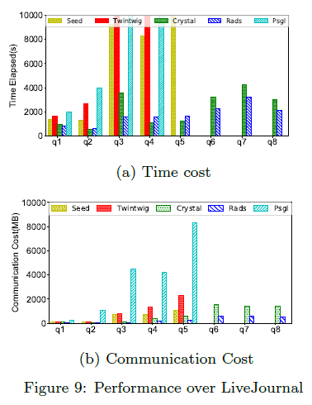
LiveJournal Dataset Results
PSgL :
Communication cost was beyond control when the query vertices reach 6
Crystal :
Achieved good performance for queries q2, q4 and q5. This is mainly because Crystal
simply retrieved the cached embeddings of the triangle to match the vertices of those 3 queries.
SEED, TwinTwig and PSgL :
Sensitive to the end vertices, such as u5 in q5. Both time cost and communication cost
increased significantly from q4 to q5.

Slide 41

UK2002 Dataset Results
Crystal :
Slightly better than that of RADS for q4 and q5 (which have triangles).
RADS:
For q2 and queries without good crystals, RADS demonstrates better performance.

Slide 42

Effectiveness of Compression
Compare the space cost of the simple embedding-list (EL) with that of embedding trie(ET).

Slide 43

Effectiveness of Query Execution Plan
RanS represents a plan consisting of random star decomposition units (no limit on the size of the star)
RanM represents plan with minimum number of rounds without considering the strategies (span, filtering power )

Slide 44

Scalability Test
Varying graph size and average degree
Generated 5 subgraphs of Friendster by extracting 20, 40, 60, 80 and 100% of the vertices.
By fixing 100% of the vertices, randomly sample 20, 40, 60, 80 and 100% of the edges to get another 5 subgraphs whose average degrees range from 11 to 55.

Slide 45

Scalability Test
Varying the number of nodes in the cluster
varying the number of nodes in the cluster from 5 to 10 and 15
Scalability ratio: total processing time of all queries using 5 nodes and that of the other two cases

Slide 46
Conclusion
Presented a novel approach for distributed subgraph enumeration.
Isolated a large part of vertices which does not have to be involved in the distributed process.
By passing edge verification results, RADS significantly reduced the network communication cost.
Proposed a compact format to store the generated intermediate results.
Query execution plan and memory control strategies helped to improve the efficiency and robustness.
Experiments verified the superiority of our approach compared with several other approaches.

